Slide 1

FORWARD COLLISION WARNING SYSTEM USING DEEP NEURAL NETWORKS
K. Akash(15135A0501)
B. Akhil(14131A5015)
K. Grishma Hari Vallabhi(14131A0548)
D. Sruthi (14131A0528)
Internal guide
Mr. Ch. Avinash
Assistant Professor
GVPCOE(A)

Slide 2
ABSTRACT
Technology is growing rapidly and the automotive industry is no stranger to this. Collision warning systems are the need of the day be it for human driver assistance or for autonomous cars. Collision detection currently is being done using technologies like radar, lidar, ultrasound etc which are very costly hence, we don’t see them in our regular cars. The motivation behind this project is to build a cost-effective solution based on computer vision. The vehicle dash cam footage is to be processed live and warning should be issued well ahead of a probable collision. We take advantage of Convolutional Neural Networks(CNN) which have shown great accuracy in identifying objects. We train a CNN to detect cars and pedestrians which a vehicle encounters on the road. Training a neural network on image data is very slow, so we take advantage of a GPU instance on cloud which greatly accelerates our deep learning application. We then estimate tracking distance, velocity and acceleration of our car with the help of comparisons performed over a set of consecutive frames from the video. We will be able to predict an imminent collision ahead of its time, so that the driver can break or maneuver the vehicle out of danger. In this project we are working on Ubuntu 16.04, Google Compute Engine(Google Cloud Platform), Python 3.5,CUDA and openCV.

Slide 3
EXISTING SYSTEM:
The current system of vehicles have expensive systems like RADAR, LIDAR,sonar, and motion sensors.
PROBLEMS IN EXISTING SYSTEM:
Using RADAR is very expensive and can’t detect small objects.
RADAR takes more time to lock on an object. (Since radio signals travel freely in air and space, it takes more time to get to the object and back.)
It cannot track if an object is decelerating at more the 1 mph/s.

Slide 4
cont...
LiDAR is a technology that collects very huge datasets that require high level of analysis and interpretation. For this reason, it may take a lot of time to analyze the data.
The wide beam used in sonar causes poor directional resolution, which can lead to limitation in CAR navigation
The slow sound speed, in comparison to optical sensors

Slide 5
Hardware Requirements:
System: Google Cloud VM Instance (Ubuntu 16.04 LTS)
Hard disk: 30 GB
Monitor: 1024 x 768 monitor (color)

Slide 6
Software Requirements:
Operating System: Ubuntu(16.04 LTS)
Coding Language: Python
Toolkit: Opencv 3.4, Caffe(Framework)

Slide 7
Data Set
KEYWORD : “Forward collision dash cam”
https://youtu.be/DNvaWnxSf0c (3:51)
Keyword: “forward collision accidents recorded in dashcam”
https://www.youtube.com/watch?v=SKhvuC4LsEI (4:13)
https://www.youtube.com/watch?v=KYangZ1AFn0 (0:21)
https://www.youtube.com/watch?v=SP6u5PC1fYI (1:01)
https://www.youtube.com/watch?v=BMhq2chMltw (5:27)
https://www.youtube.com/watch?v=IZhlTlqhr6Y (5:53)

Slide 8
HEADON CRASHES CARS
https://www.youtube.com/watch?v=-zehWqiIX6E (11:24)
https://www.youtube.com/watch?v=9YI0Ct1V4LU (7:23)
Accidents in America dashcam:
https://www.youtube.com/watch?v=5jP5wmnLIRo (11:02)
https://www.youtube.com/watch?v=idoD_tYTKtc (5:04)
accidents in india dashcam forward collision:
https://www.youtube.com/watch?v=1tjBKbTfwGQ (0:40)
https://www.youtube.com/watch?v=eBi6vYawlRA (0:30)

Slide 9
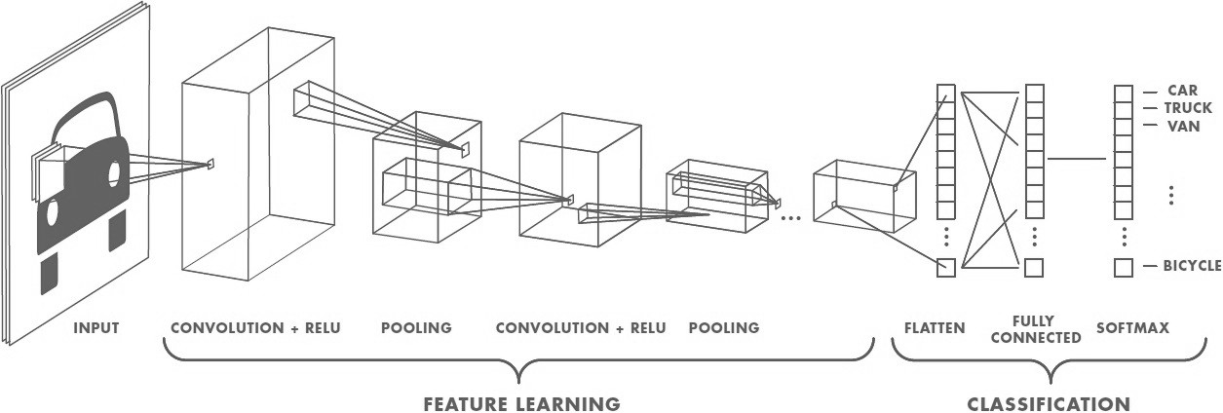

Slide 10
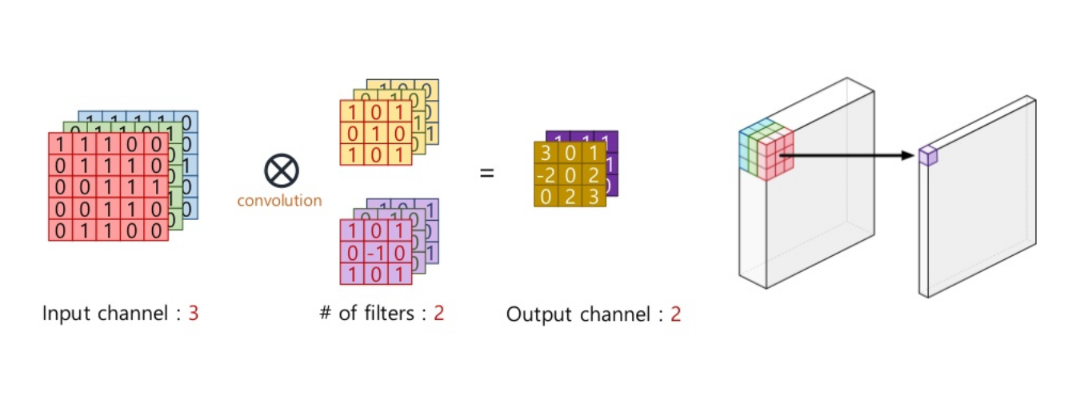

Slide 11
PROPOSED SYSTEM:
Computer vision is being used for object detection, using the Convolutional neural networks.
SSD(Single Shot Detectors) is the primary object detection method.
The MobileNet_SSD + deep neural network (dnn) module in OpenCV is used to build our object detector.
Bounding boxes are being drawn around the detections on the frames as they are processed.

Slide 12
Dashcam data is being processed at high fps rate i.e. real-time so that warnings can be given to the user ahead of time
Hence , GPU is used which makes neural network detection a lot faster .
The application is deployed on a Ubuntu VM instance hosted on Google cloud platform, which provides nvidia K80 tesla GPU (12 GB RAM).
Since the VM instance does not have a GUI , ‘X11 forwarding’ is used to connect to the remote cloud and display the output on the local machine
Google cloud server will perform the computations while showing the visual output on local system using ssh.

Slide 13
Based on the extremities of these bounding boxes, the tracking distance is calculated with reasonable accuracy.
A threshold value of distance eight meters is set.
Once the value is less than the threshold value, an alert is sent in the form of a beep sound to the driver.

Slide 14
CODE
python deep_learning_video_detection.py
import numpy as np import argparse import cv2 import sched , time import imutils
val=0

Slide 15
CONT..
ap = argparse.ArgumentParser() ap.add_argument("-i", "--image", required=False, help="path to input image") ap.add_argument("-p", "--prototxt", required=True, help="path to Caffe 'deploy' prototxt file") ap.add_argument("-m", "--model", required=True, help="path to Caffe pre-trained model") ap.add_argument("-c", "--confidence", type=float, default=0.2, help="minimum probability to filter weak detections") args = vars(ap.parse_args())

Slide 16
CONT..
CLASSES = ["background", "aeroplane", "bicycle", "bird", "boat", "bottle", "bus", "vehicle", "cat", "chair", "cow", "diningtable", "dog", "horse", "motorbike", "person", "pottedplant", "sheep", "sofa", "train", "tvmonitor"] COLORS = np.random.uniform(0, 255, size=(len(CLASSES), 3)) print("[INFO] loading model...") net = cv2.dnn.readNetFromCaffe(args["prototxt"], args["model"])
cap = cv2.VideoCapture("input_video.mp4") frame_width = int(cap.get(3)) frame_height = int(cap.get(4))

Slide 17
CONT..
fourcc =cv2.VideoWriter_fourcc(*'XVID') out = cv2.VideoWriter('output.avi', fourcc , 20.0, (frame_width,frame_height))
while True: ret, image = cap.read() (h, w) = image.shape[:2]# height , width blob = cv2.dnn.blobFromImage(cv2.resize(image, (300, 300)), 0.007843, (900, 900), 127.5) net.setInput(blob) detections = net.forward()

Slide 18
CONT..
for i in np.arange(0, detections.shape[2]): confidence = detections[0, 0, i, 2] if confidence > args["confidence"]: idx = int(detections[0, 0, i, 1])
if idx == 7 or idx == 15 : box = detections[0, 0, i, 3:7] * np.array([w, h, w, h]) (startX, startY, endX, endY) = box.astype("int")

Slide 19
CONT..
label = "{}: {:.2f}%".format(CLASSES[idx], confidence * 100) cv2.rectangle(image, (startX, startY), (endX, endY), COLORS[idx], 2) y = startY - 15 if startY - 15 > 15 else startY + 15 cv2.putText(image, label, (startX, y), cv2.FONT_HERSHEY_SIMPLEX, 0.5, COLORS[idx], 2)
out.write(image) cv2.imshow("Output", image)

Slide 20
CONT..
if val==1: cv2.destroyAllWindows() print main_func('result.png') break if cv2.waitKey(33)==27: cap.release() out.release() break cv2.waitKey(0)

Slide 21
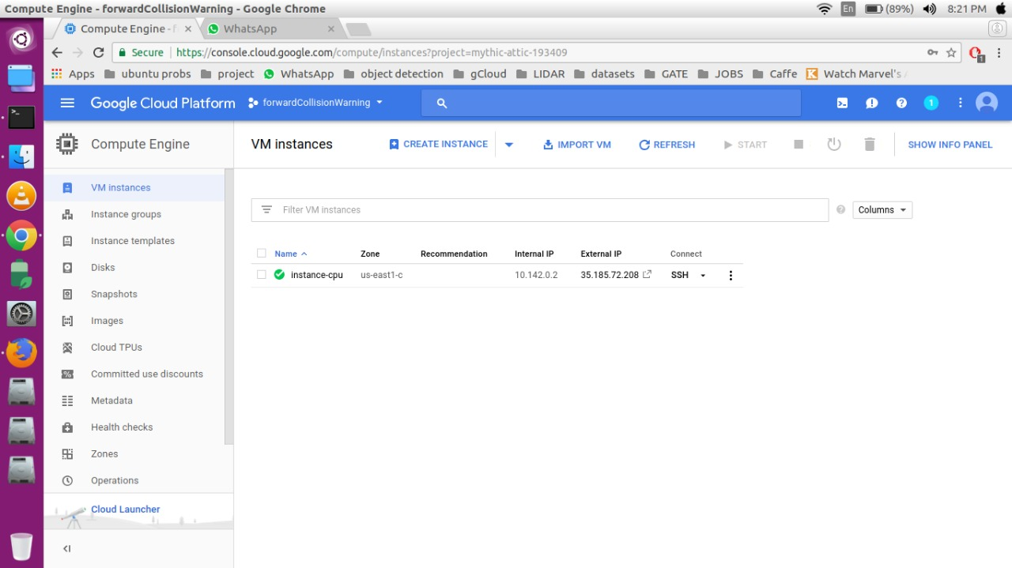

Slide 22
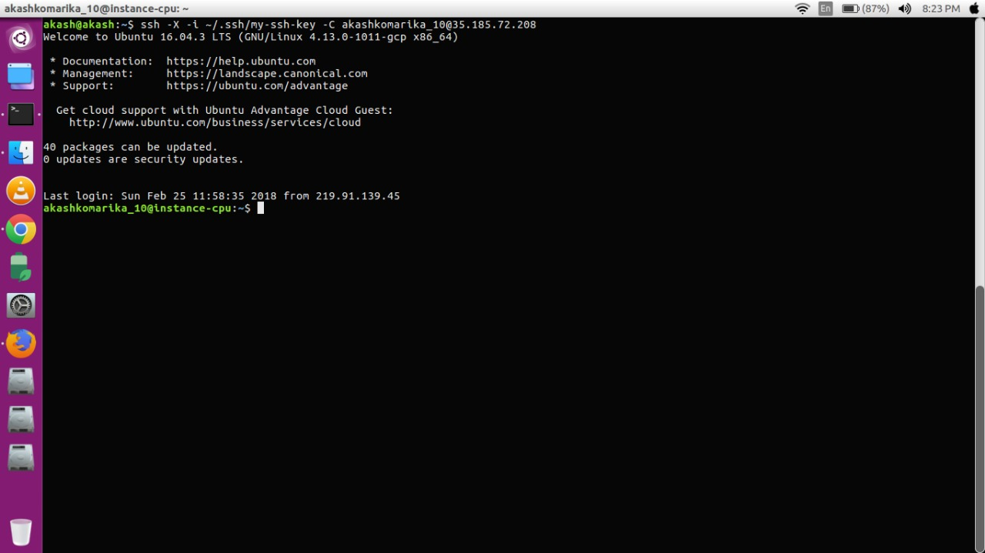
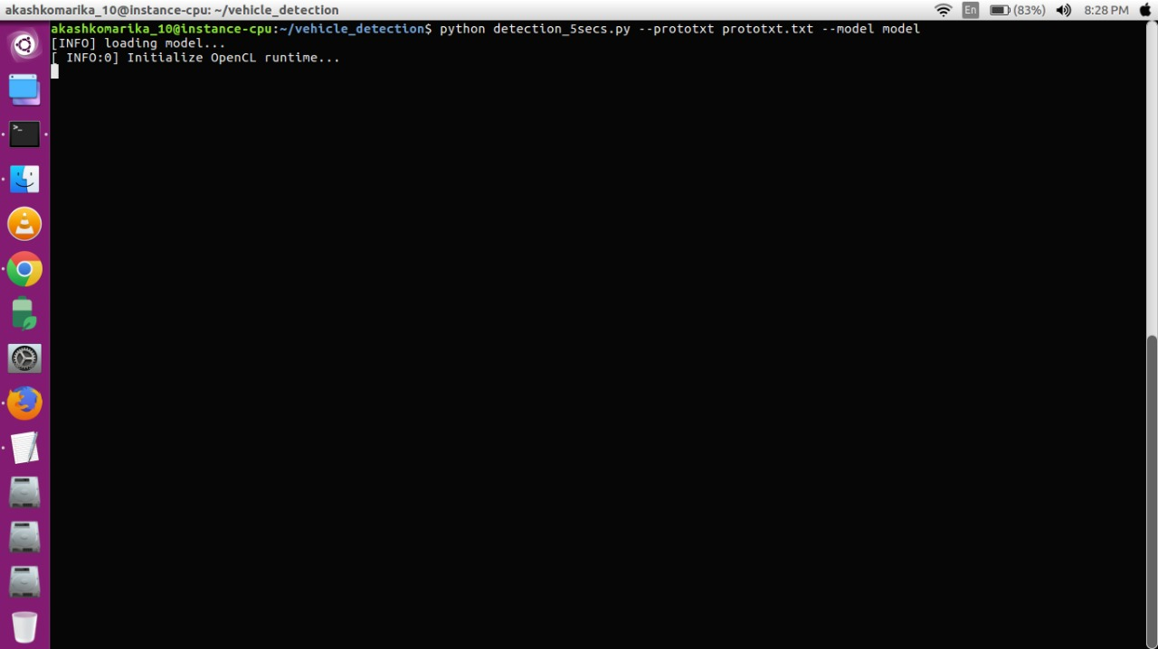

Slide 23
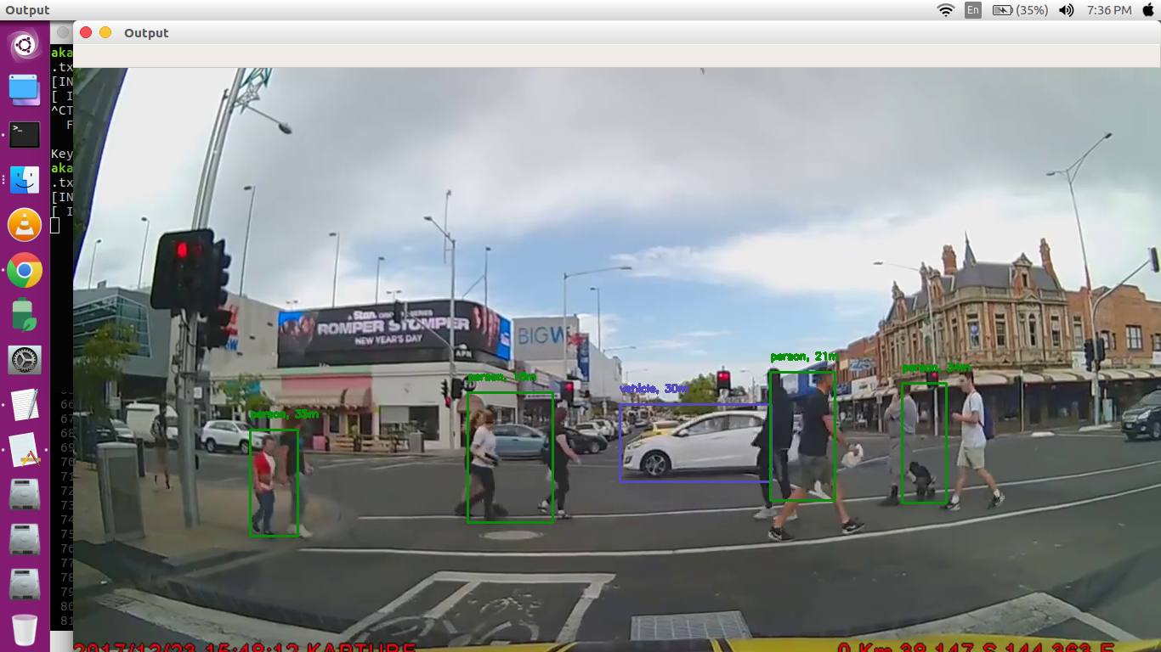
Output Screens

Slide 24
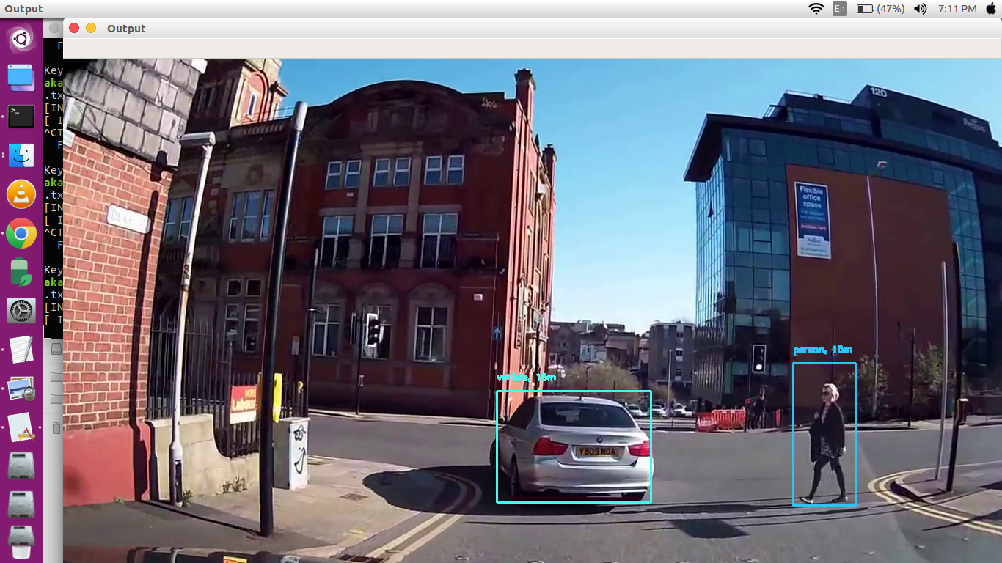

Slide 25
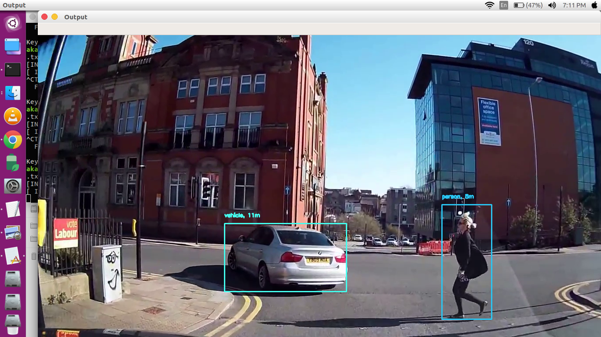

Slide 26
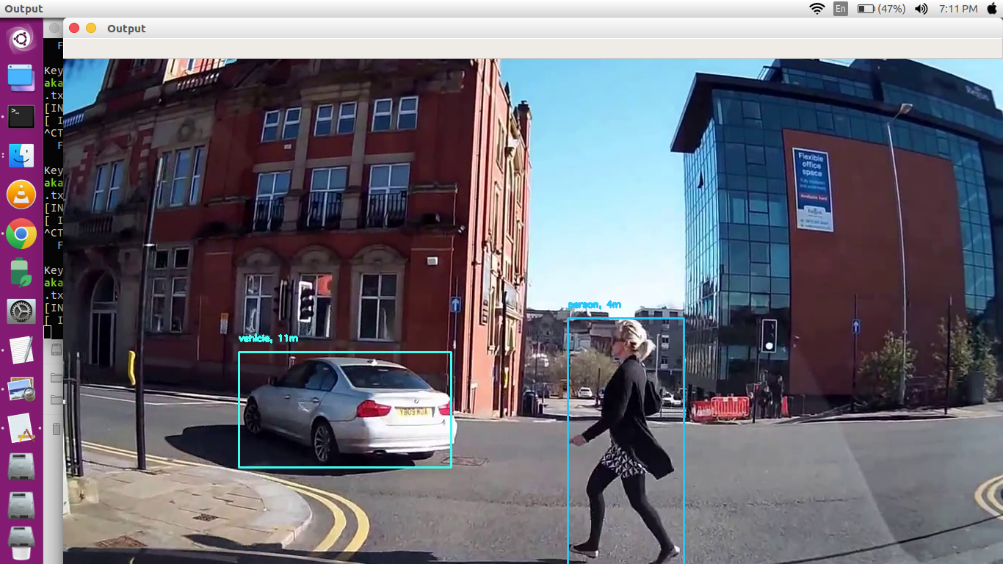

Slide 27
THANK YOU

